Slide 1
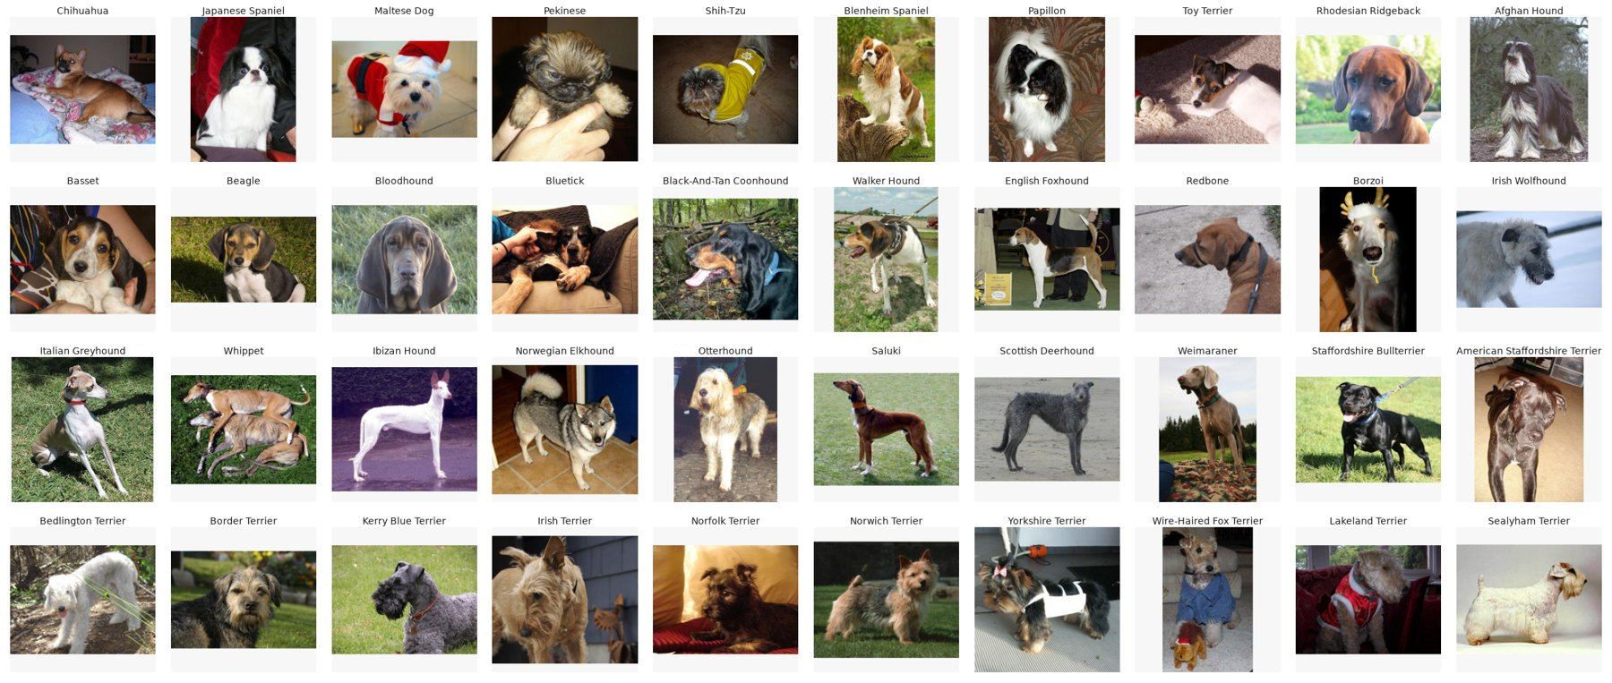
Dog Breed Classification on Stanford Dogs
ITRI626 Mini Project: Deep learning for image classification
Sulaiman Sulaman 45427429
Lindani Mdlalose 46290303
JP Retief 38279118
Notes:
Hello everyone, our project was about classifying dog breeds. The goal was to use transfer learning to train different models to classify dog breeds accurately.

Slide 2
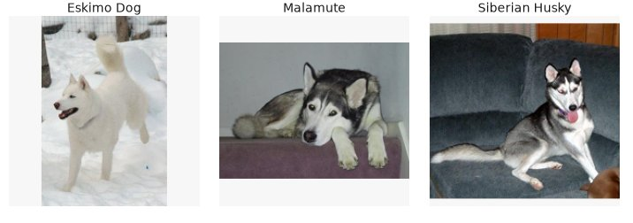
The Problem
Eskimo dog, malamute and Siberian husky
Classify a photo of a dog into one of 120 breeds
Fine-grained: some breeds look almost identical
Breed is often guessed by eye at shelters and vets
Aim: compare three model families and recommend one
2
Notes:
The problem here is that image classification network would have to deal with very subtle visual traits. As you can see the Eskimo Dog, Malamute and the Siberian Husky look alike in colour and size.
In practice, shelters and clinics would rely on subjective eye assessments, leading to misidentification.
For this project, each one of us trained models from separate families to assist the workers with the identifying dog breeds.

Slide 3
Dataset
Stanford Dogs (Khosla et al., 2011), via Kaggle
20,580 photos, 120 breeds
148 to 252 photos per breed
70/15/15 split, stratified, seed 42
Some image were duplicates – same image in different classes.
Reduced the breeds to 114 total, by merging some similar classes.
3
Notes:
We used Stanford Dogs, which contains over 20,500 images across 120 breeds, with a 70/15/15 stratified split to train, validate, and test.
Each class has about 150 to 250 images which is relatively small for deep learning.
When we checked the dataset, we discovered some images were duplicated over some classes. The models were first trained on the uncleaned dataset, and then on a cleaned dataset where the duplicates was removed by my discretion after viewing the classes and browsing the dog's typical features.

Slide 4
Models
Model | Family | Parameters | Pretrained
Custom CNN | VGG-style CNN | 4.6 M | No
MobileNetV3-Large | MobileNet (control) | 4.4 M | ImageNet-1K
EfficientNetV2-S | EfficientNet | 20.3 M | ImageNet-1K
Swin-T | Swin Transformer | 27.6 M | ImageNet-1K
MobileNetV3 is the same size as our CNN but pretrained, so comparing the two shows what pretraining alone is worth.
4
Notes:
We firstly trained a Custom CNN from scratch.
Then two beefy transfer learning architectures: EfficientNetV2-S and the Swin Transformer-T
And MobileNetV3-Large which is pretrained on ImageNet but is similar in size the custom CNN and therefore shows directly the benefit of transfer learning.

Slide 5
Transfer Learning and Setup
Transfer learning
Start from ImageNet-1K weights
Epochs 1–2: train only the new output layer
Epochs 3–5: unfreeze upper layers, lower learning rate (1e-5)
Setup
224×224 input; flips, small rotations, colour jitter
AdamW, batch 32, label smoothing 0.1
Custom CNN: up to 60 epochs, early stopping
Same split and metrics for every model
5

Slide 6
Results
Model | Accuracy | Top-5 | Macro F1
Swin-T | 88.0% | 99.3% | 0.875
EfficientNetV2-S | 83.1% | 97.8% | 0.825
MobileNetV3-Large | 67.5% | 91.8% | 0.671
Custom CNN | 53.8% | 84.8% | 0.532
Held-out test set, 3,200 photos
Pretraining alone (same size, MobileNetV3 vs our CNN) added 13.7 points.
6

Slide 7
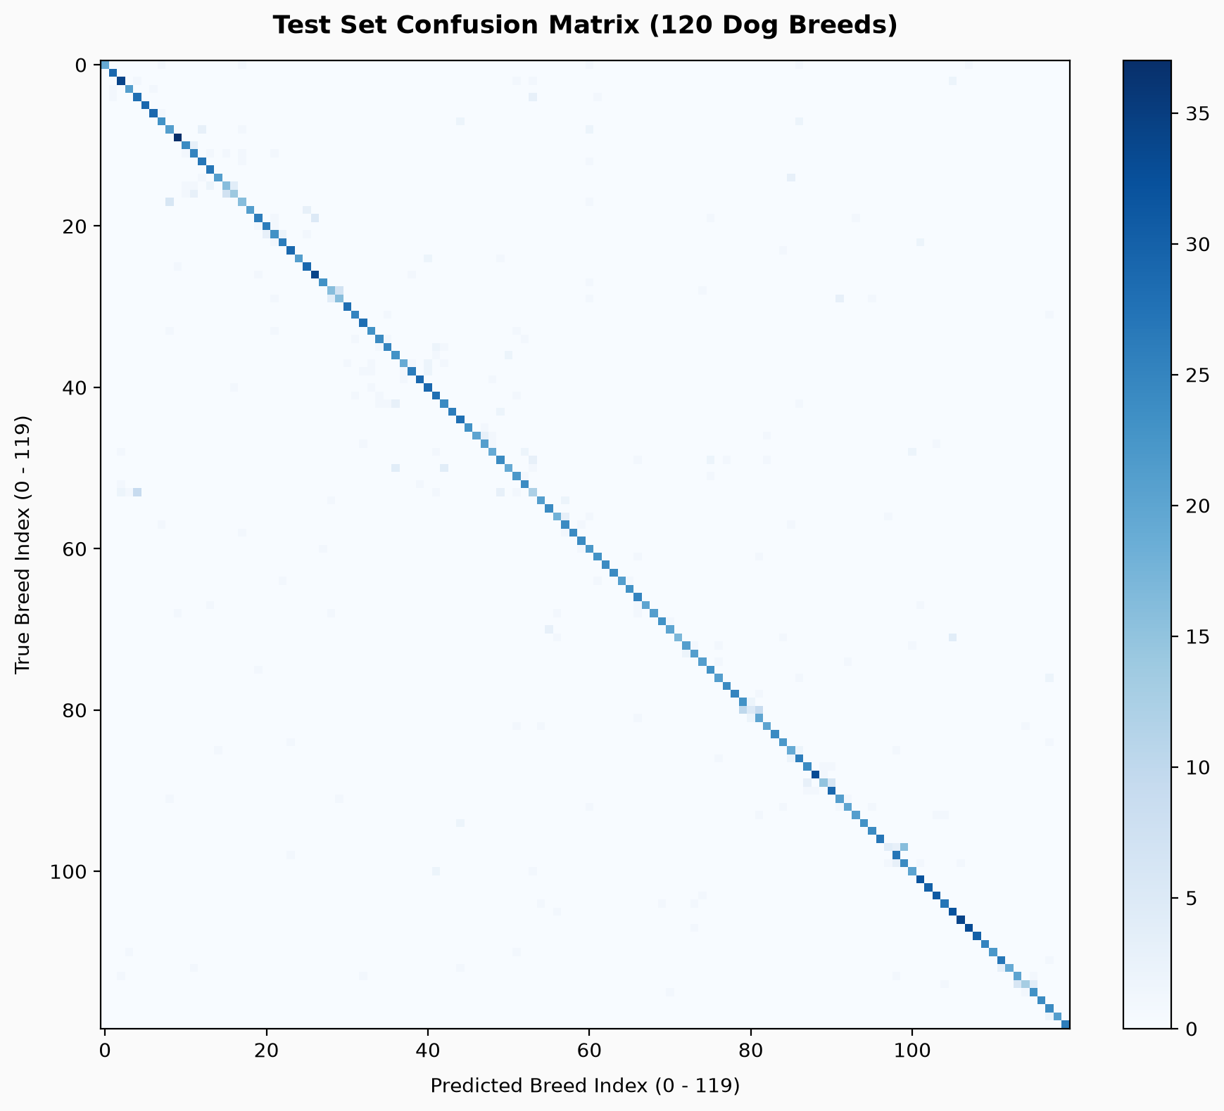
Confusion Matrix
7
Swin-T, all 120 breeds

Slide 8
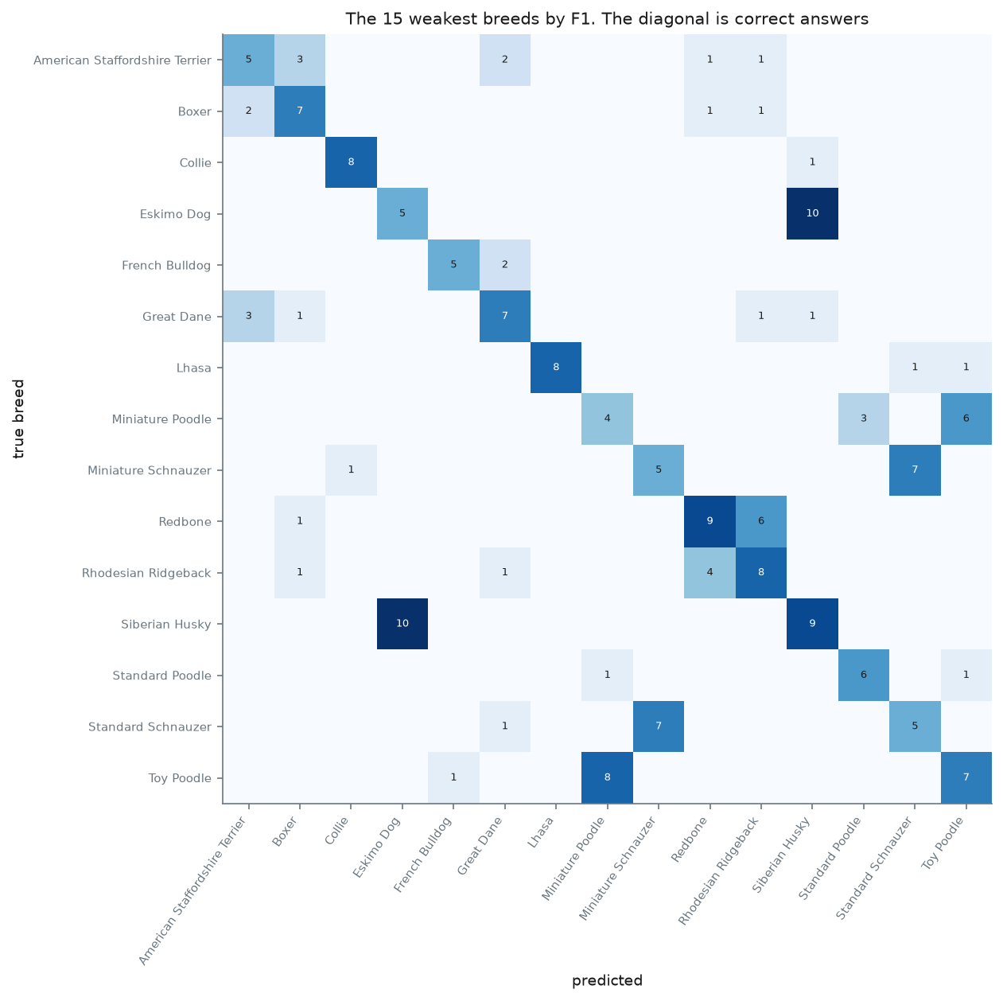
Confusion Matrix
Eskimo dog was predicted as husky 10 times
Toy and miniature poodles get mixed up
Both models struggle on the same breeds
7
Custom CNN, 15 weakest breeds

Slide 9
Limitations and Lessons Learned
Limitations
Each model was trained only once
Pretrained models only ran 5 epochs
Test photos may overlap with ImageNet
Wrong labels in the dataset cap accuracy
Lessons learned
Check the data before training
A same-size control makes comparisons fairer
Measure leakage if you can’t avoid it
Use one shared pipeline for all models
8

Slide 10
Conclusion
We recommend Swin-T: 88.0% accuracy and the best macro F1
EfficientNetV2-S is a good CNN alternative (about 5 points lower)
Pretraining made the biggest difference
Label errors in the dataset limit every model
Next step: test on an independently collected dataset
Thank you. Any questions?
9

